Slide 1


PYTHON
Lecture 49

Slide 2

Today’s Agenda
Database Programming In Python-I
What Is Data And Database ?
What Is DBMS ?
What Is SQL ?
How To Configure Our System For Database Programming In Python ?

Slide 3
Introduction
Before we learn about Database Programming In Python, let's first understand -
What is Data?
What is Database ?

Slide 4
Introduction
What is Data?
In simple words data can be facts or information.
For example your name, population of a country , names of political parties in your country , today’s temperature etc
A picture , image , file , pdf etc can also be considered data.

Slide 5
Introduction
What is a Database?
A database is a collection of inter-related data or information that is organized so that it can easily be accessed, managed, and updated .
Let's discuss few examples.
Your mobile’s phone book is a database as it stores data pertaining to people like their phone numbers, name and other contact details etc.
Your University uses database to store student details like enrollment no, name , address , academic performance etc
Let's also consider the Facebook. It needs to store, manipulate and present data related to members, their friends, member activities, messages, advertisements and lot more. Here also database is used

Slide 6
How Databases Store The Data ?
Most of the databases store their data in the form of tables
Each table in a database has one or more columns, and each column is assigned a specific data type, such as an integer number, a sequence of characters (for text), or a date.
Each row in the table has a value for each column.

Slide 7
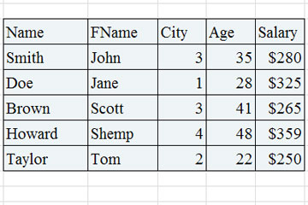
How Databases Store The Data ?

Slide 8
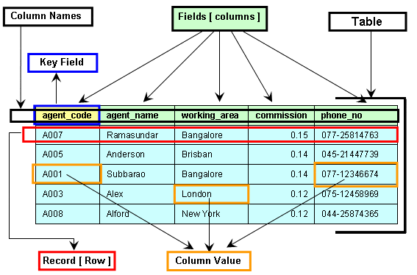
Components Of A Table

Slide 9
What Is A DBMS ?
A DBMS is a program or a software that allows users to perform different operations on a database.
These operations include:
Creating the database/tables
Inserting records into these tables
Selecting records from these tables for displaying
Updating / Deleting the records

Slide 10
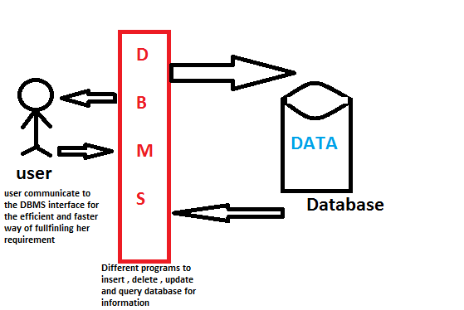
What Is A DBMS ?

Slide 11
Some Popular DBMS
Some of the most popular DBMS are:
Oracle
MySQL
MS SQL Server
SQLite
PostgreSQL
IBM DB2
and many more

Slide 12
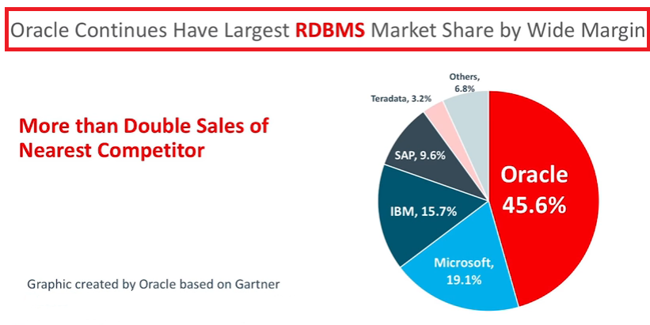
The Market Leader

Slide 13
What Is SQL ?
SQL is an abbreviation for “Structured Query Language”.
It is a language used by EVERY DBMS to interact with the database.
It provides us COMMANDS for inserting data to a database, selecting data from the database and modifying data in the database

Slide 14
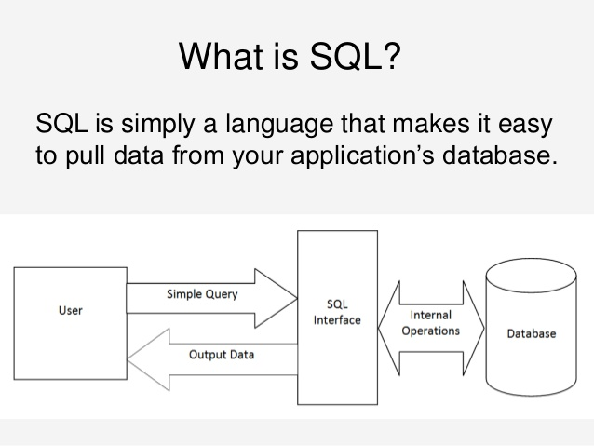
Pictorial View Of SQL

Slide 15
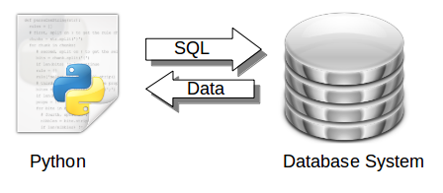
Database Programming In Python
Python is wonderfully able to interact with databases, and this is what we will learn in this chapter.
Advantages:
Platform-independent
Faster and more efficient
Easy to migrate and port database application interfaces

Slide 16
How Python Connects To Database?
Python uses the Python Database API in order to interact with databases.
An API stands for Application Programming Interface.
It is a set of predefined functions , classes and methods given by the language for a particular task and the programmer can use it whenever he wants to perform that task in his code.

Slide 17
How Python Connects To Database?
The Python Database API allows us to handle different database management systems (DBMS) in our Python code.
However the steps at the code level remain altogether same.
That is using the same steps we can connect to Oracle or MySQL or SQLite or any other DBMS

